Slide 1
WM Recall & Recognition Task

Slide 2


Task Diagram
Recognition Trial
SOA: 400-500 ms
100 ms
900 ms
Response (3000 ms)
SOA: 400-500 ms
100 ms
900 ms
Response
Recall
Trial
Notes:
Blocks of 25; mix recognition and recall trial blocks (smaller)
Plot as function of K?? Not sure why???

Slide 3
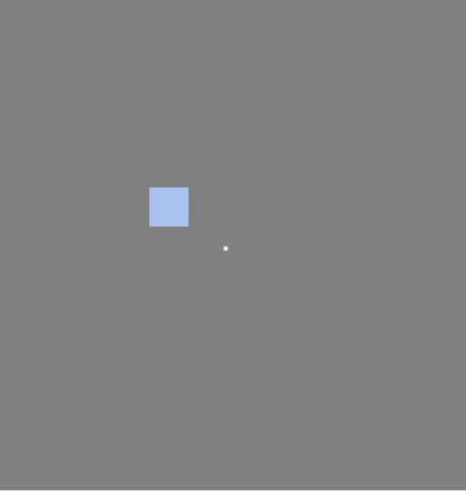
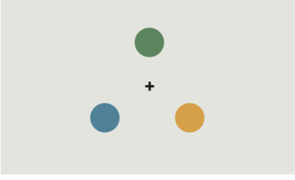
Recognition (Change Detection) - Question
Probe screen: One pop up or all three with only one color changing or not?
Zhang and Luck (2008) use one, but others have also used three
MB Answer: Show only one.

Slide 4
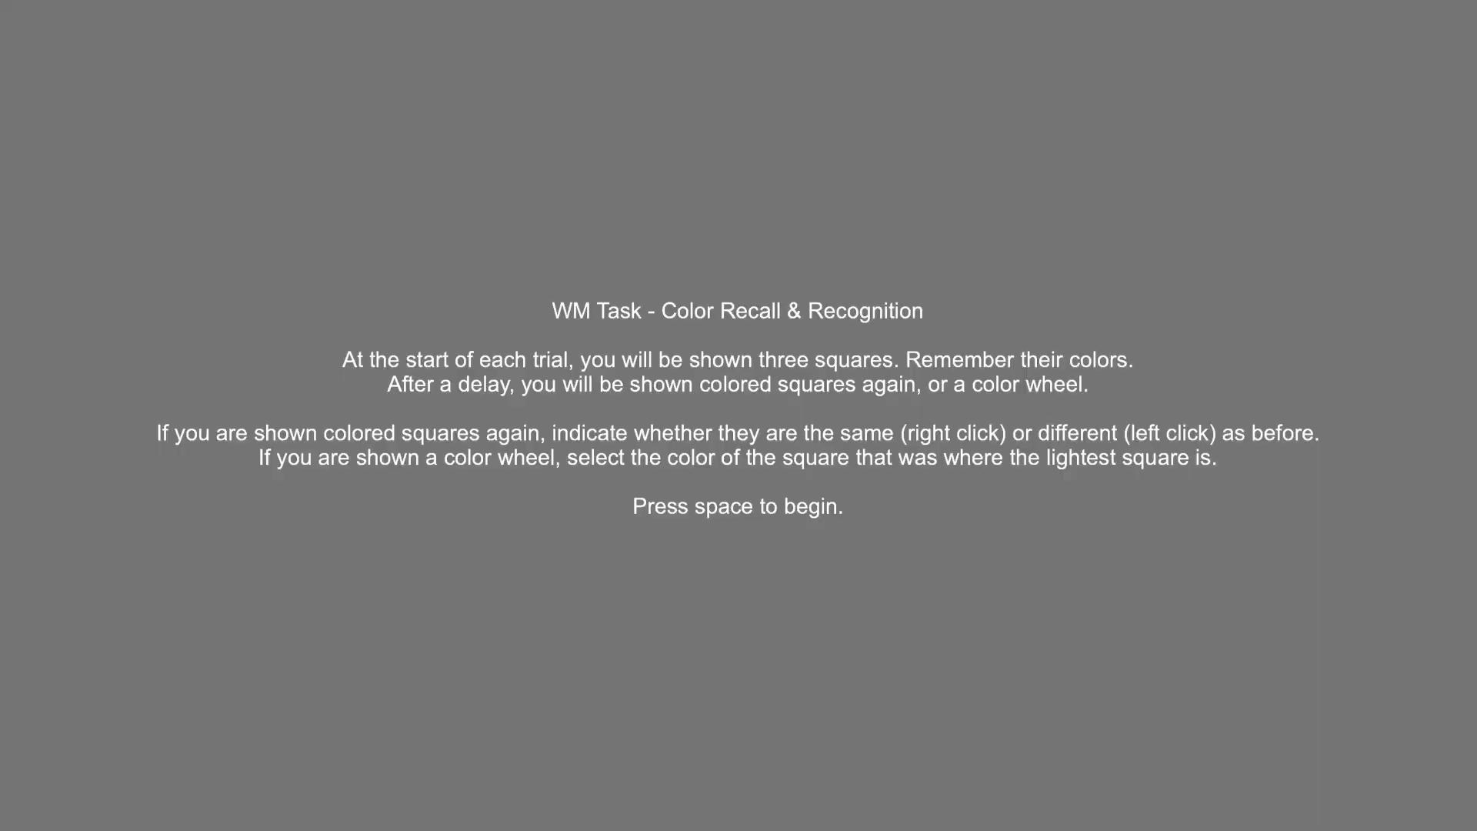
Intermixed
Example

Slide 5
Study Design
[MB Said: WILL NEED TO CHECK 1st vs 2nd half of trials - may be too long]
For reference: 10 trials takes about 1 minute
Blocked: 100 trials of each (recall, recog.) ~20 mins with break at 10m
How many blocks? 2 or more?
MB Answer: Blocks of 25 and mixed together recall, recog
Intermixed: 100 trials of each (recall, recog.) ~20 mins with break at 10m
Assent: ~5 mins
Practice trials: 20 trials each (recall, recog.) ~5 mins
Block version only? Easier to explain one at a time
MB ANSWER: Yes.
Demographics and questionnaires = ~10 mins
Notes:
Blocked trials for pora

Slide 6
mTBI Questionnaire
Do we include a question about mTBI location?
E.g., Where did you hit your head (e.g., forehead, back of head, right side, left side)?
MB Answer: Not explicitly. Not in IRB. Add to please describe question.
Reason: Recognition engages parietal structures, while recall engages frontal structures. We are looking at the effect of intermixing vs. blocking trials to tease apart frontal or parietal damage.

